Slide 1
CHARATERISTIC PATH LENGTH AND SMALL WORLD NETWORLS
Course : Graph Theory (CS-601)
Degree : BSCS
Batch : 2k19-2k23
Submitted To : Ma'am Sadaf Gull
Submitted By : GIRLS (BSCS 7th)

Slide 2
Path
In graph theory, a path in a graph is a finite or infinite sequence of edges which joins a sequence of vertices which, by most definitions, are all distinct.
A directed path in a directed graph is a finite or infinite sequence of edges which joins a sequence of distinct vertices, but with the added restriction that the edges be all directed in the same direction.
Undirected path graph in which any two vertices are connected by exactly one path, or equivalently a connected acyclic undirected graph. A forest is an undirected graph in which any two vertices are connected by at most one path, or equivalently an acyclic undirected graph, or equivalently a disjoint union of trees.
A path is a particularly simple example of a tree.

Slide 3
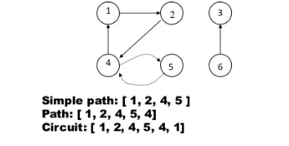
Path
A path is Simple is if each vertex is distinct.
Path us said to Circuit or Cycle if it's terminal vertex coincides with the initial vertex.

Slide 4
Path length
Path Length The actual length of the path traversed by the body between the Initial and Final positions is known as the path length.
The path length is a scalar quantity, meaning it has simply a magnitude and no direction.

Slide 5
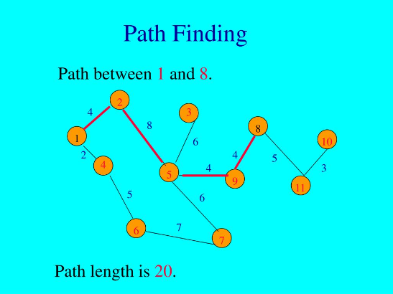
Path Length

Slide 6
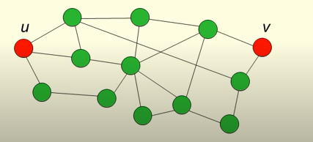
Path length=Shortest Distance
The Shortest Path length or simply path length between two vertices u and v in a graph G is the length of the shortest path from u to v.
We can find different path from u to v that have different Path length can be 3,4,5,6,7.
Path length= 3=Shortest path length
So we can denotes d(u, v) the path length between u and v.

Slide 7
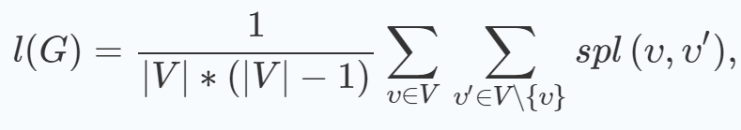
Characteristic Path Length
It is also know as Average path length
The characteristic path length l(G) of a graph G = (V, E) is defined as the average number of edges in the shortest paths between all vertex pairs

Slide 8
Characteristic Path Length
where spl(υ,υ′) gives the number of edges in a shortest path between vertices υ and υ′.
In case of an unconnected graph, the characteristic path length is infinite, as the number of edges between two unconnected vertices is considered infinite.
In this case, formula is often modified to sum over just all connected vertex pairs. Alternatively, other measures such as the harmonic mean or the average inverse path length can be used.

Slide 9

Average path length
Average path length of a connected Graph G is the average of the pair of the vertices of the path lengths
d(u,v)=0 , if u=v

Slide 10
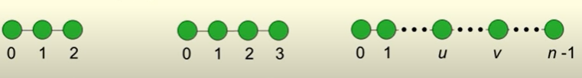
Average path length
If we take 0,1,2 then d(0,1)=d(1,2)=1 and d(0,2)=2 now it's L(G) = 1+1+2/3=4/3
If we take 0,1,2,3 then d(0,1)=d(1,2)=d(2,3)=1 , d(0,2)=d(1,3)=2 and d(0,3)=3 now it's L(G)=3(1)+2(2)+3/6=5/3
If we take 0 to n-1 then the formula is described in the above

Slide 11
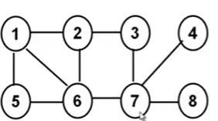
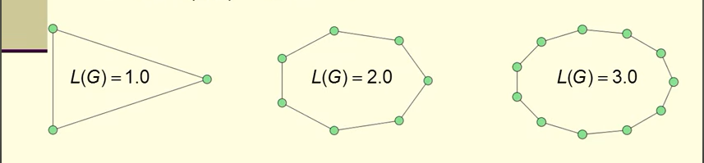
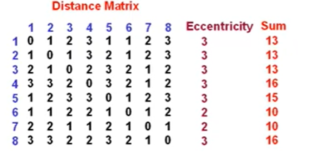
Characteristic Path Length OR Average path length
Average path length= 106/(8*7)=1.89

Slide 12
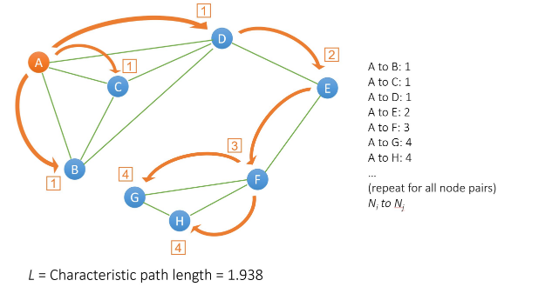
Characteristic Path Length
Another example

Slide 13

Small World Networks
A small-world network is a type of mathematical graph in which most nodes are not neighbors of one another, but the neighbors of any given node are likely to be neighbors of each other and most nodes can be reached from every other node by a small number of hops or steps.
Specifically, a small-world network is defined to be a network where the typical distance L between two randomly chosen nodes (the number of steps required) grows proportionally to the logarithm of the number of nodes N in the network, that is:
The main mechanism to construct small-world networks is the Watts–Strogatz mechanism

Slide 14
Examples
Small-world properties are found in many real-world phenomena, including websites with navigation menus, food webs, electric power grids, metabolite processing networks, networks of brain neurons, voter networks, telephone call graphs, and airport networks,Cultural networksand word co-occurrence networkshave also been shown to be small-world networks.

Slide 15
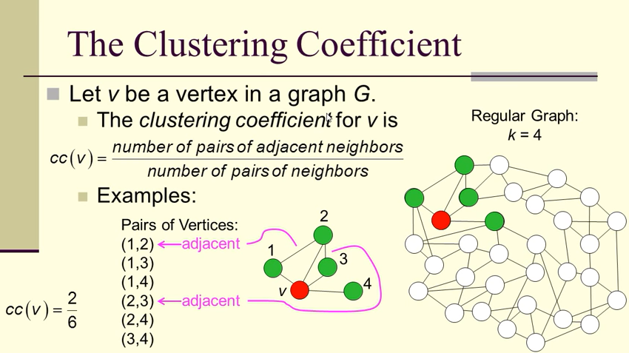
The Clustering Coefficient
In graph theory, a clustering coefficient is a measure of the degree to which vertex in a graph tend to cluster together.

Slide 16
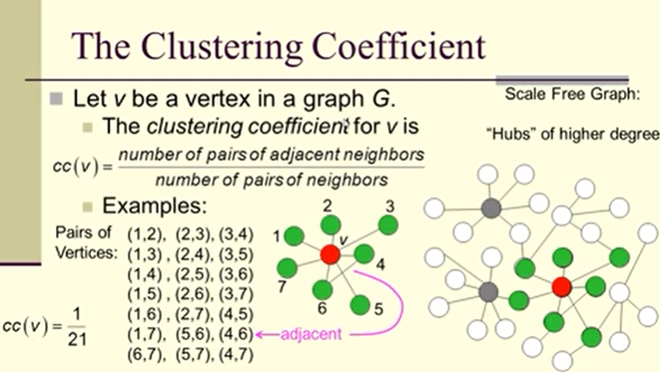
The Clustering Coefficient

Slide 17
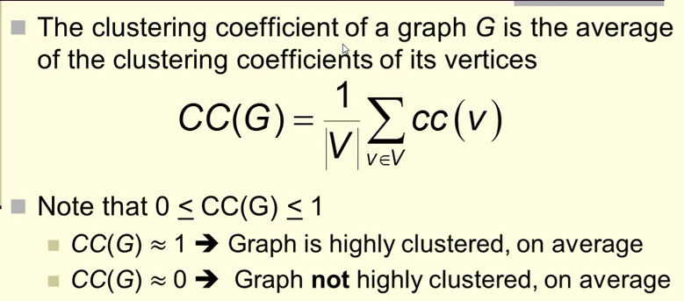
The Clustering Coefficient

Slide 18
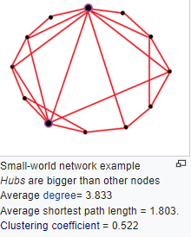
Small world Network Example

Slide 19
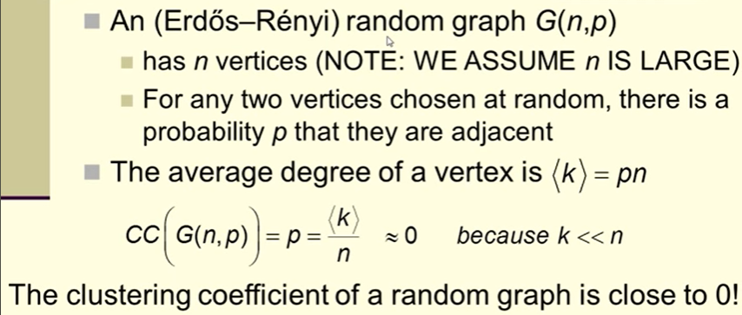
Random (Erdos Renyi) Graph

Slide 20
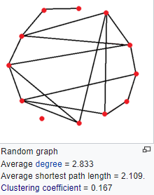
Example Random Graph

Slide 21
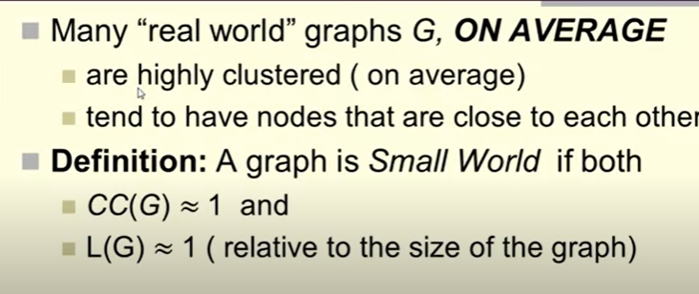
Small World PHENOMENOA

Slide 22
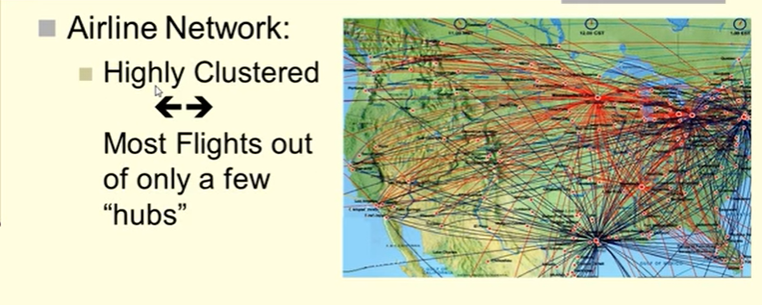
Continued..........

Slide 23
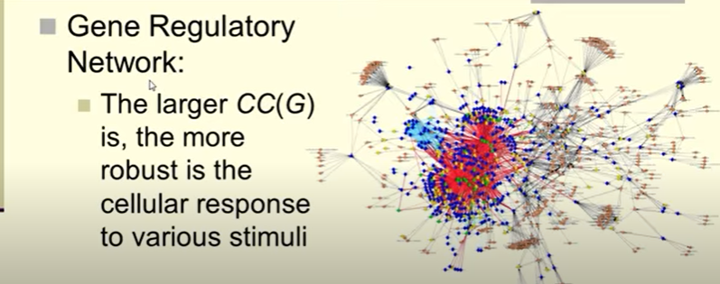
Continued..........

Slide 24
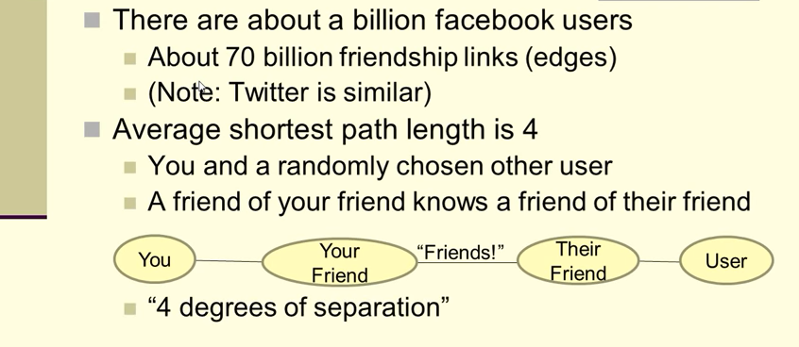
Example : Facebook

Slide 25
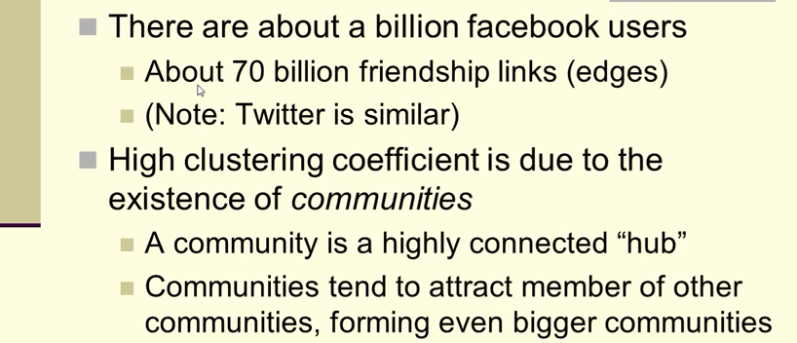
Continued.........

Slide 26
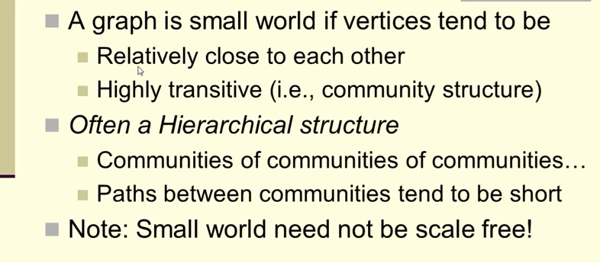
Small World Graph

Slide 27
Application SWN
Applications to sociology
The advantages to small world networking for social movement groups are their resistance to change due to the filtering apparatus of using highly connected nodes, and its better effectiveness in relaying information while keeping the number of links required to connect a network to a minimum.
Applications to earth sciences
Many networks studied in geology and geophysics have been shown to have characteristics of small-world networks.

Slide 28
Continued........
Applications to computing
Small-world networks have been used to estimate the usability of information stored in large databases.
Small-world neural networks in the brain
Both anatomical connections in the brain and the synchronization networks of cortical neurons exhibit small-world topology. Structural and functional connectivity in the brain has also been found to reflect the small-world topology of short path length and high clustering

Slide 29

.

